Slide 1
Extra Meeting
April 10, 2023
The Little Engineers that Could: Blake, Sam, Melanie, and Amy

Slide 2
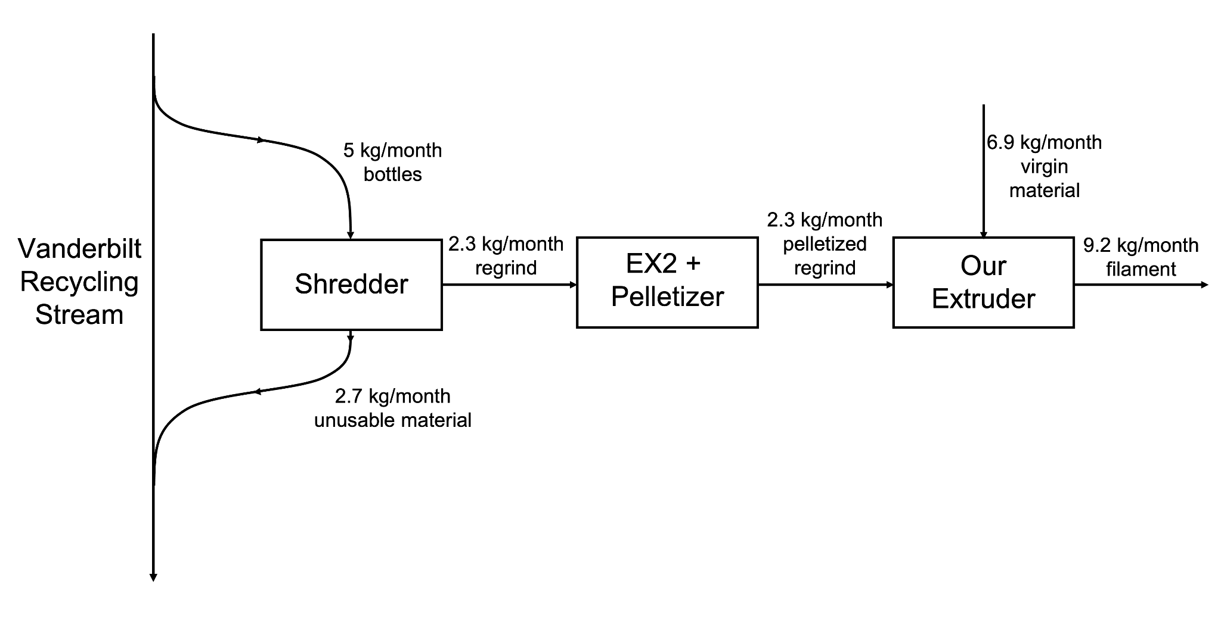
Last Week’s Progress
Website is up, running, and getting better each day
Main focus is still finishing the extruder (wiring everything, putting parts together), but as more of the extruder is built, more time will be spent on writing
Fans work, fan shrouds fit => just need to make sure housing can support weight and screws are long enough
⅔ shrouds are printed
We know how ⅔ of the PIDs are wired/programmed and will test them this week
Made last order of big purchases (enough heaters for whole barrel, coupler, aluminum extrusion, connection to wall power)
Characterized recycle stream and finished PFD (attached on next page)
Filmed and edited Design Day video

Slide 3
Next Steps
Wire the rest of the PIDs
Keep updating the website
Still waiting on several items to ship in (housing, coupler, power supply, wall connector)
Machining the flange and thermocouple connections
Barrel bearing

Slide 4
Questions
Fastening heaters to barrel => what kind of tape?
Is reimbursement an option, and if so, how could we go about that?

Slide 5
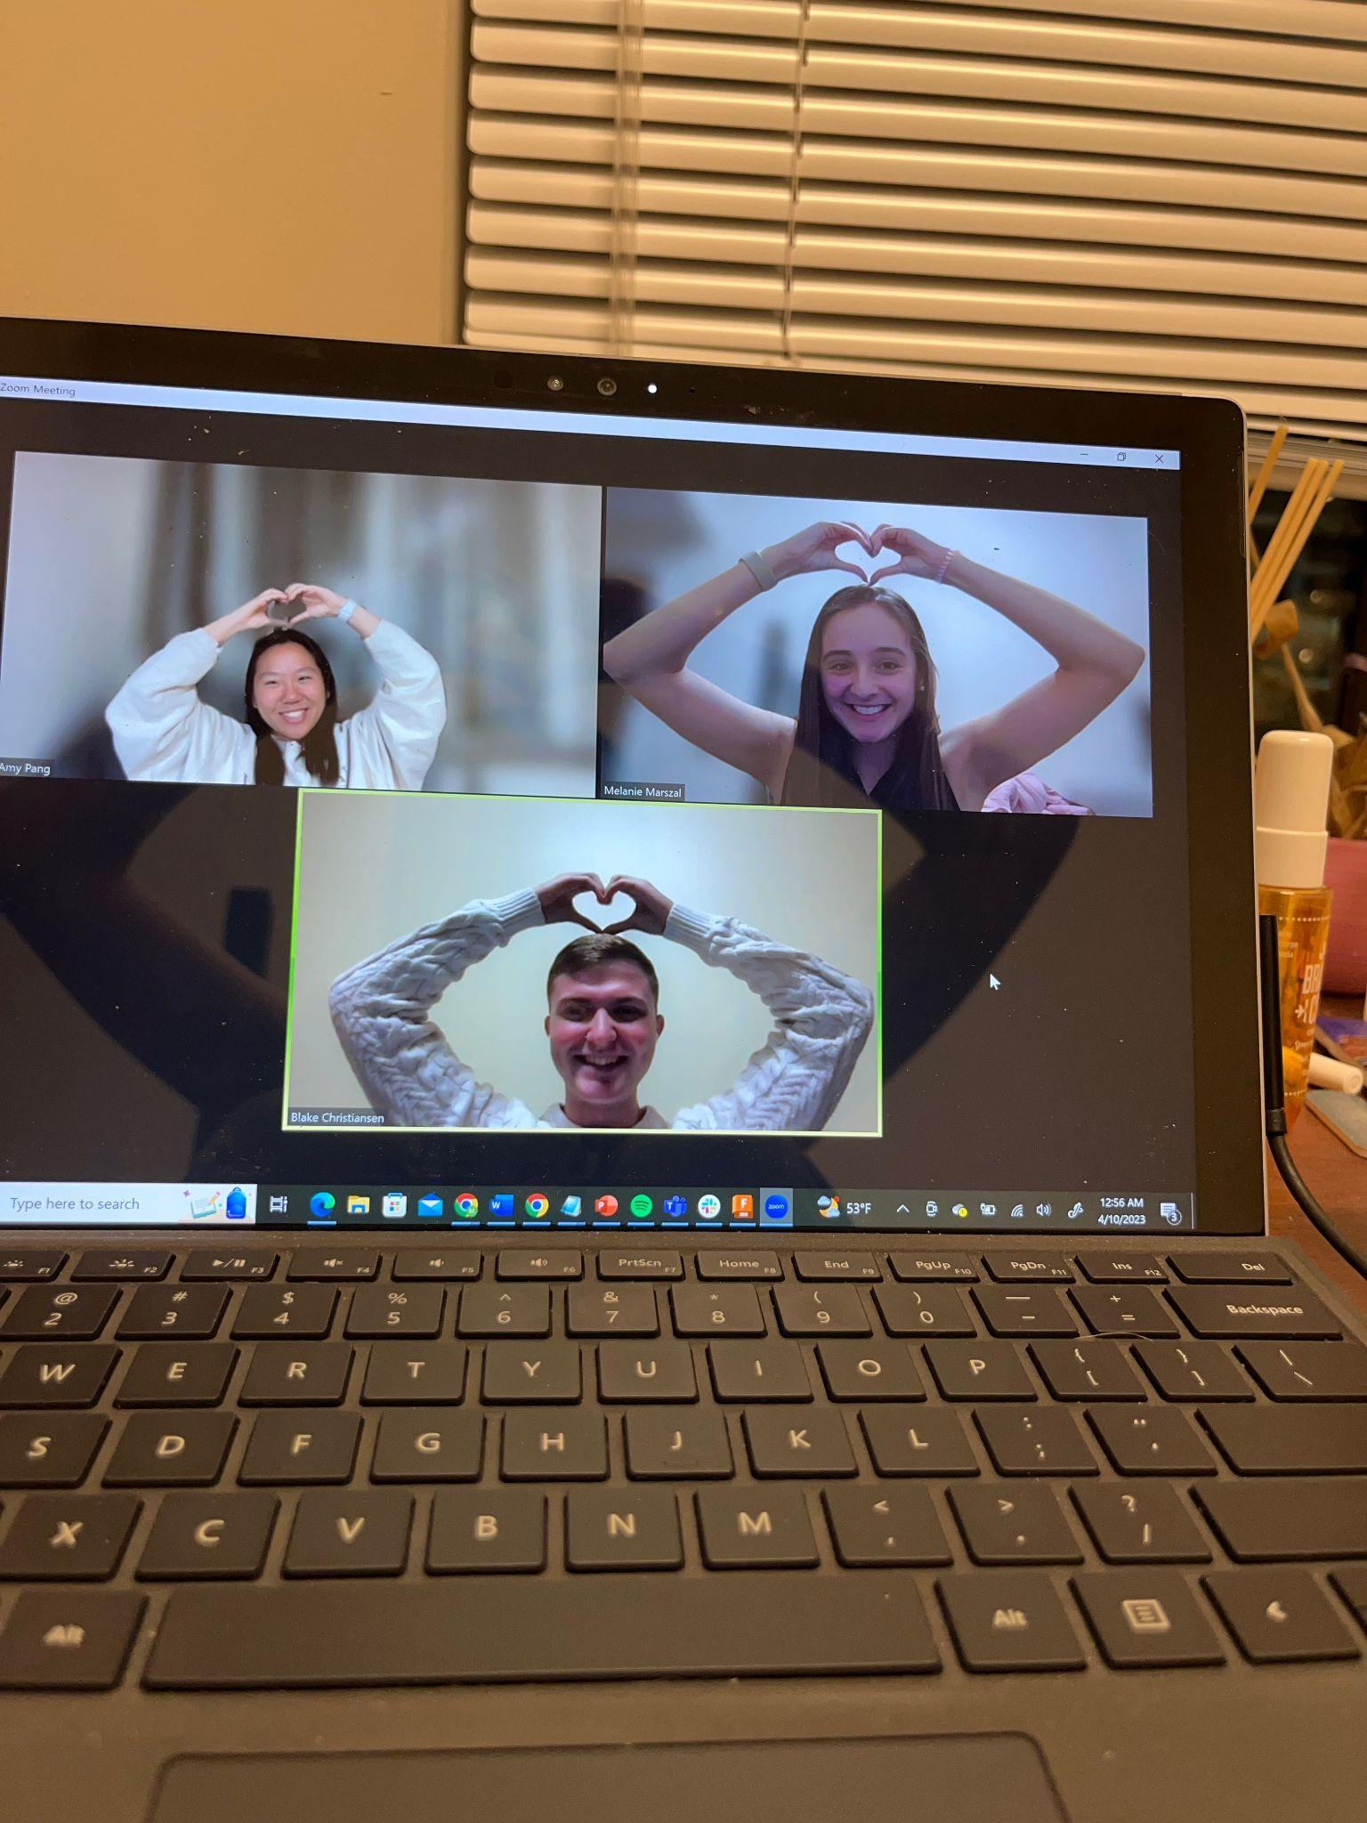
“Keep calm and carry on”
Amy Pang

